Slide 1
Bank Customer Churn Analysis
Ruchel Weissman
July 2024

Slide 2
Business Problem:
High customer churn impacting revenue and growth.
The dataset used in this study, referred to as the Bank Churn Dataset, was sourced from a bank's customer database. For each customer it contains both personal details and account-related information.
The objective of this project is to understand what factors are causing customer churn.
High level approach to solving the problem
The goal of this project is to develop a churn prediction model for the banking sector to better understand the factors leading to customer churn. By identifying these factors and predicting potential churners, the project aims to help the bank devise effective customer retention strategies.

Slide 3
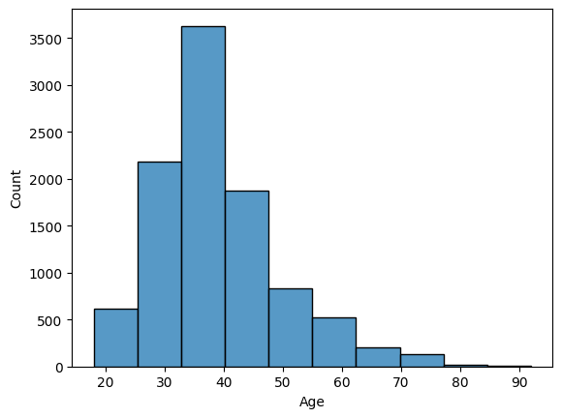
Data
Age Distribution
The dataset contains 18 features for each of the 1,000 customers tracked. The features include age, location, salary, credit card ownership, the number of bank products held, card type, and whether the customer had lodged any complaints.
The target variable for this study is the "Exited" column, indicating whether a customer has exited the bank.
The data is from 3 countries: Spain, France and germany.
Average customer age is 39 with a standard deviation of 10. The min age is 18 max is 92.
The average tenure is 5 years, the longest is 10.
The data set was very clean and no missing values were detected.

Slide 4
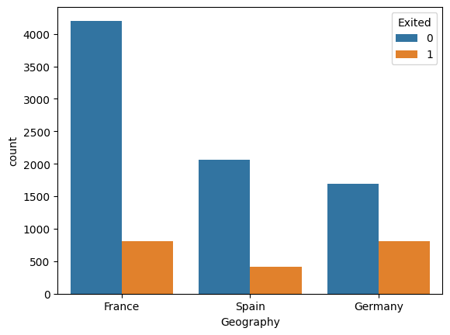
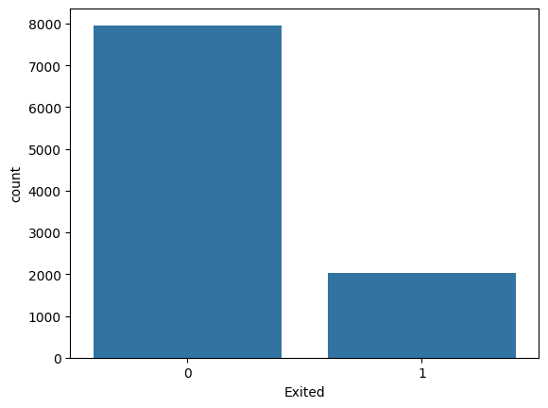
Exploratory Data Analysis
Only about a quarter of all the people churned so the data is imbalanced.
Most customers are from France but Germany has the highest churn percentage.

Slide 5
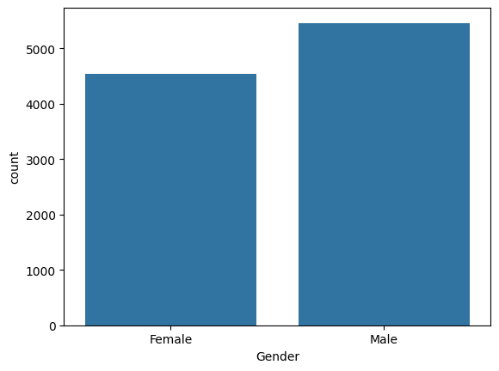
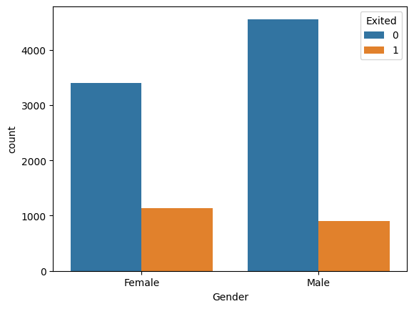
When analyzing the gender we see that there are a bit more males than females, but females tend to churn more.

Slide 6
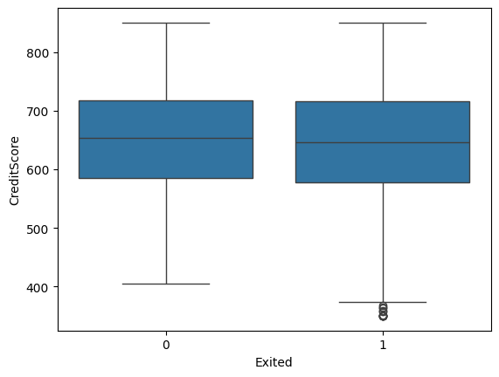
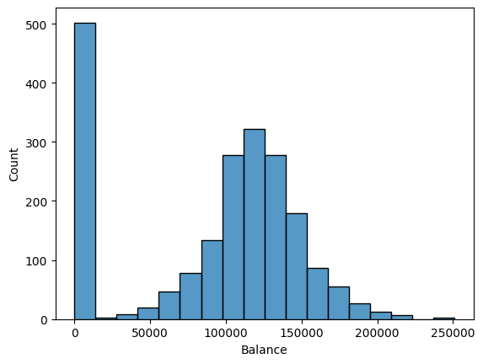
Largest number of people who churn have a 0 balance
Credit scores are very similar but the ones that don't churn but have a slightly lower median and lower outliers as well.

Slide 7
Methodology
Model Selection:
Basic Models: Logistic Regression, Kneighbors, SVC, Gaussian NB
Advanced Models: Random Forest, XGBoost, Gaussian Mixture
Deep Learning Models: CNN
Evaluation Metrics:
Accuracy, Precision, Recall, F1-Score, AUC.

Slide 8
Predictors and Target Variables
Target Variable:
Exited: Binary variable indicating if a customer has churned (1) or not (0).
Predictor Variables:
Demographics: Age, gender, geography.
Account Information: Balance, number of products, tenure.
Customer Engagement: Participation in loyalty programs
Historical Data: Previous complaints

Slide 9
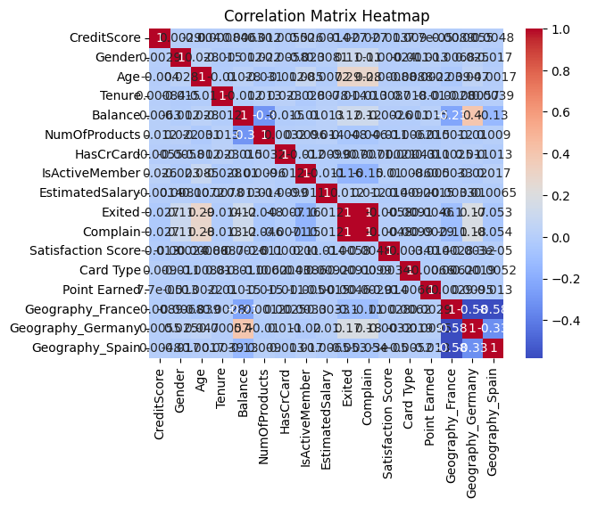
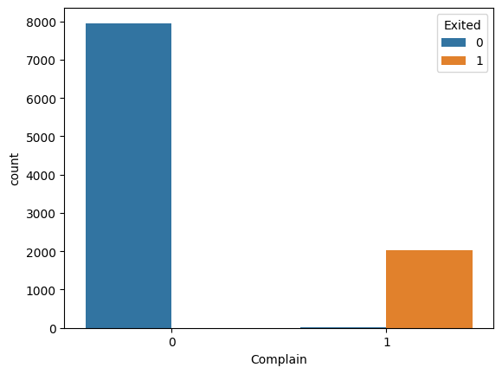
Correlations
Complain is correlated to exited.

Slide 10
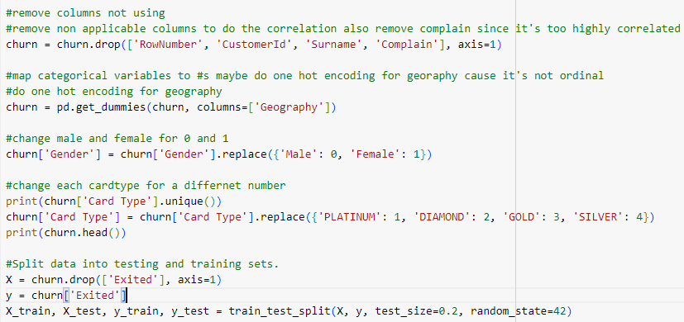
Removed columns not using including complaint since is too highly correlated for any of the other variables to matter.
Converted categorical variables to numeric. Used one hot encoding for geography since its not ordinal.
Split into testing and training

Slide 11
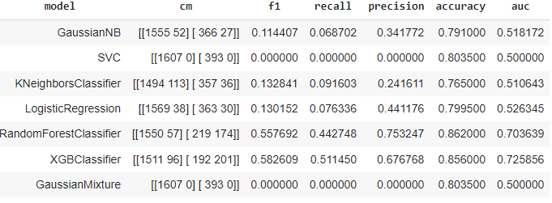
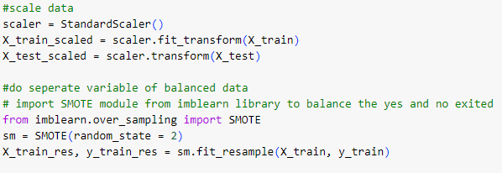
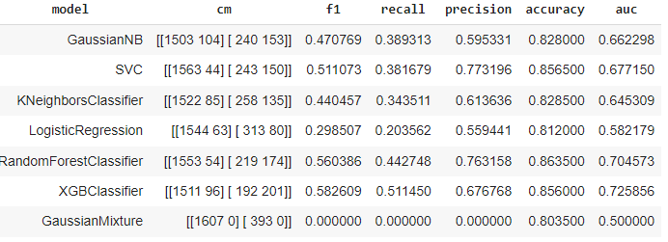
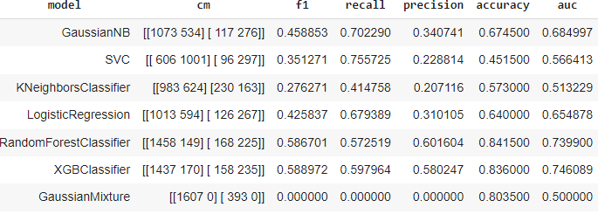
Regular Data
Prepared 3 version of the data set to test which one performs best.
Regular version, scaled version, balanced version.
Scaled Data
Created a function that tries it on a list of models.
Initial results of model on all 3 versions of the data.
Balanced data had highest scores on f1 score and recall which is what matters most for churn prediction.
Weighted Data

Slide 12
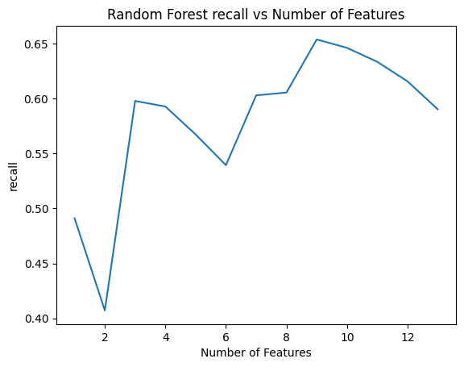
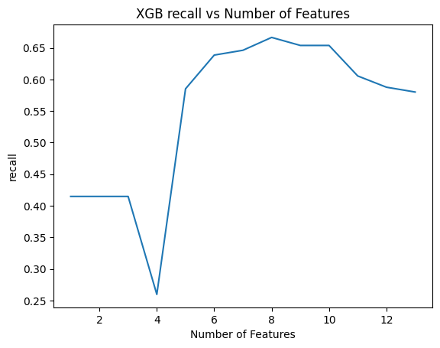
Additional data engineering for the 3 highest performing models.
Tried doing pca and rfe to select best features. Used line plot to visualize best number of features for each model.
Used 8 for xgb model and 9 for the random forest.

Slide 13
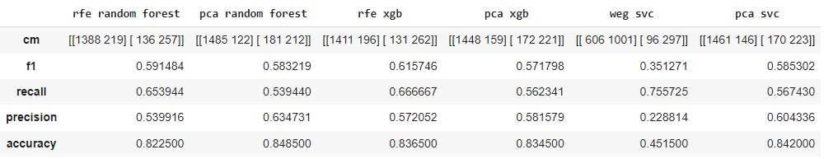
Looking at recall the svc model on the regular dataset still performs the best. With the optimized xgb second.
If we look at f1 score the optimized xgb performs best with svc on pca data second.
Will go with the optimized xgb model as that one is one of top two on both merics looking at and performs much better than svc on other metrics as accuracy and precision

Slide 14
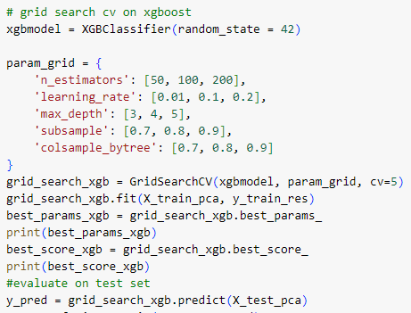
Additional models and fine tuning
Tried an advanced cnn model but the results weren’t close to the top models here
Used Grid search cv to get best parameters but it did not increase the scores.

Slide 15
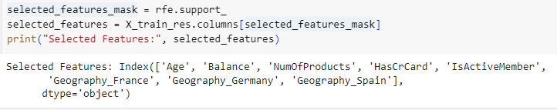
Top Features
Looking at the top features that indicate churn most seem more personal related and not necessarily something going on from the banks part that they need to improve. So we can use the model to predict who might be likely to churn and offer them products, services to incentivize them to stay.

Slide 16
Next Steps
Future work could focus on enhancing model transparency, perhaps through the integration of explainable AI techniques, to facilitate better understanding
Might try to incorporate findings for real time decision making.
Time series data from each customer over time would be extremely helpful to help determine when individuals churn over a series of years.

Slide 17
Lessons Learned from the Project
Importance of Feature Selection:
Removing highly correlated features (e.g., the "complaint" column) can prevent overfitting and lead to more realistic model performance.
Feature selection techniques such as Recursive Feature Elimination (RFE) can help in identifying the most significant features, improving both model performance and interpretability.
Handling Imbalanced Data:
Imbalanced datasets can significantly impact model performance.
Techniques such as SMOTE (Synthetic Minority Over-sampling Technique) are effective in balancing the dataset and improving the model's ability to identify minority class instances (e.g., churned customers).
Evaluating Model Performance:
It's important to evaluate models on multiple metrics (accuracy, precision, recall, F1 score, AUC) to get a comprehensive understanding of their performance.

Slide 18
Appendix
Python Code

Slide 19
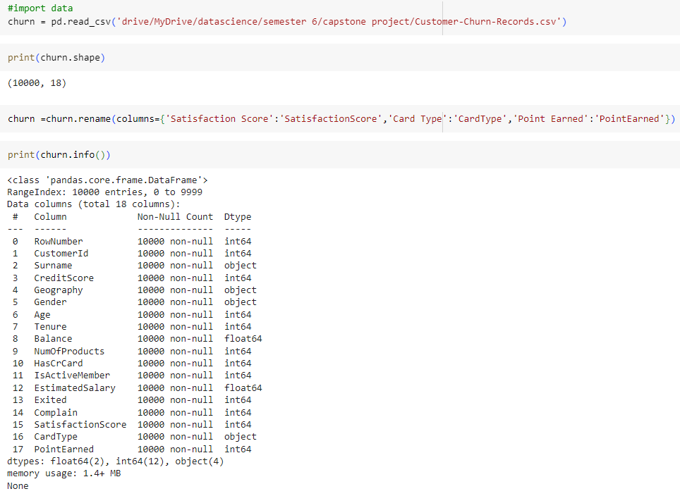
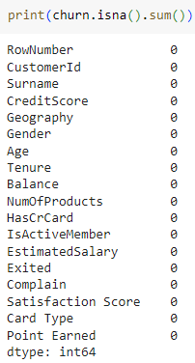

Slide 20
